Slide 1
Privacy Tools
For Library Public Computers

Slide 2






Privacy Badger
DuckDuckGo
Tor Browser
HTTPS Everywhere
Onion Share
Unpaywall (not really a privacy tool)
Notes:
Libraries have intellectual freedom as a core value
This is easy to protect in physical space – i.e. we don’t monitor our patrons behavior
This is difficult to protect in digital space – i.e. a number of entities are directly monitoring our patrons behavior
These are the tools that we have at our disposal to protect that value.

Slide 3
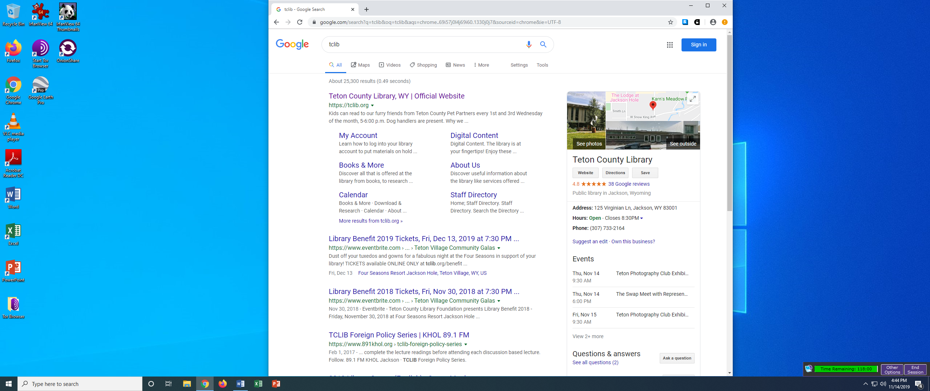


Slide 4
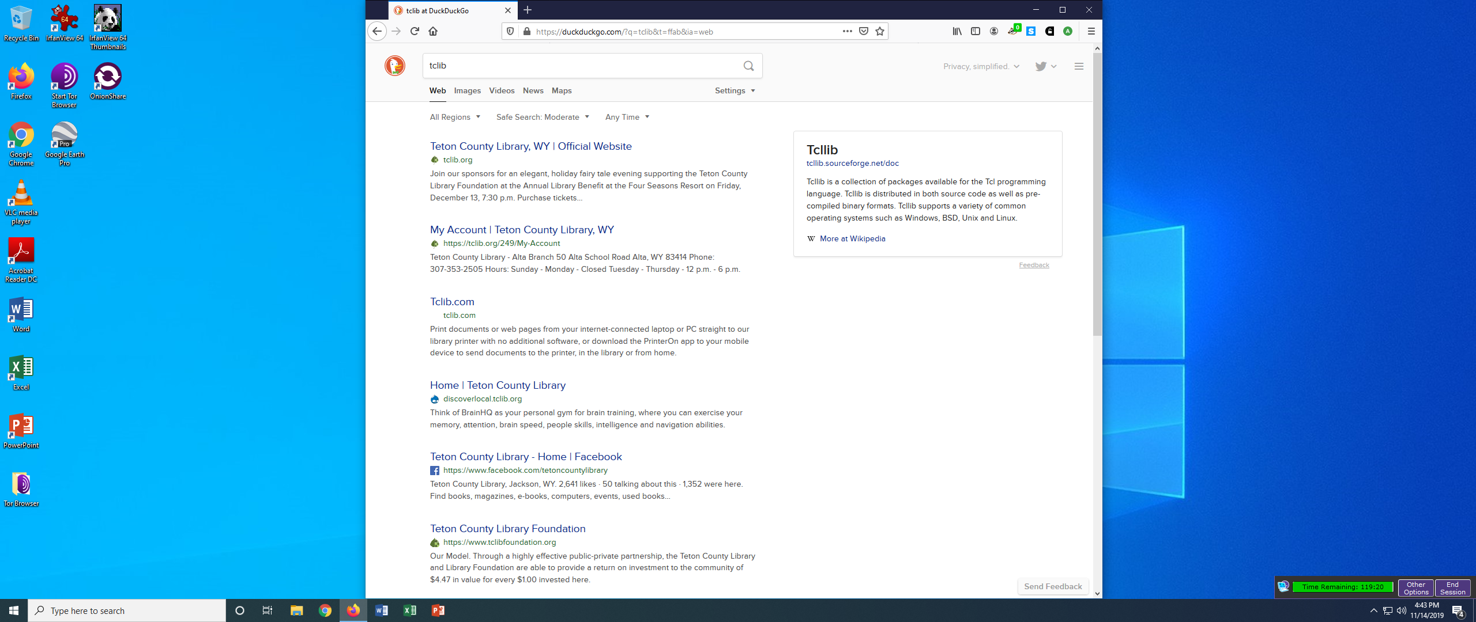


Slide 5
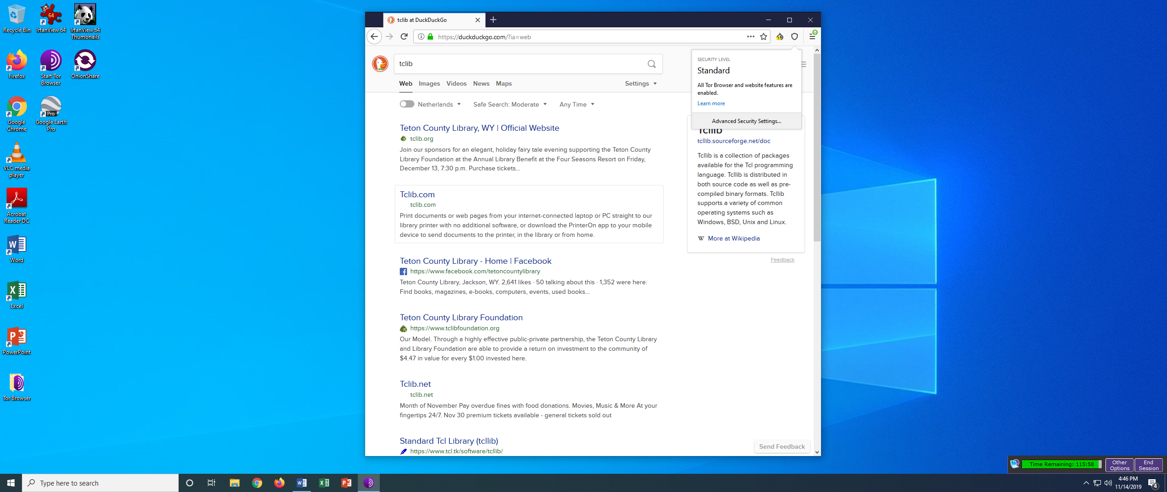

Slide 6
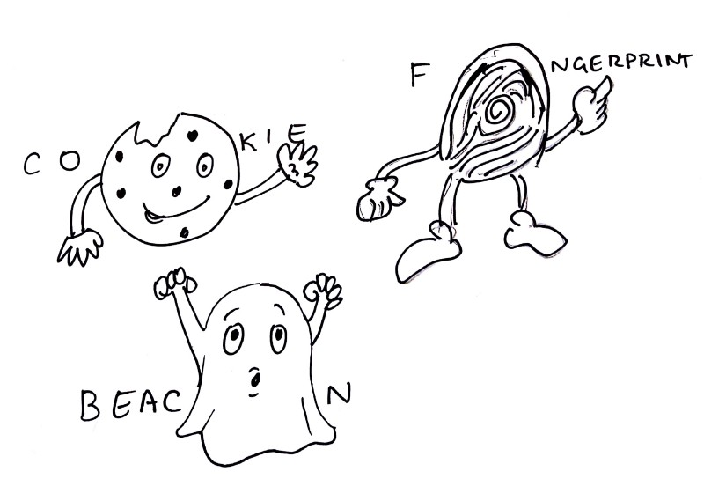
Cookie: Monitors your session and communicates your behavior.
Beacon: Used to measure the presence or interaction with ads.
Fingerprint: Can identify you with cookies blocked, makes it possible to follow your web browsing to and from different pages.
Notes:
Who is watching – web companies, ISP companies, Government agencies
Web companies use web tracking to monitor us, how does that work --
Cookies are the most widely known method to identify a user. They use small pieces of data (each limited to 4 KB) placed in a browser storage by the web server. When a user visits a website for the first time, a cookie file with a unique user identifier (could be randomly generated) is stored on the user’s computer.
Subsequent visits to the Facebook page do not require you to login, because your details will be remembered by the browser through a cookie stored during your first login.
Modern websites use cookies for two main purposes - keeping you logged in and tracking your behavior.
third party tracking using cookies:
In practice, websites usually track non-logged in users in using external, third-party software like Google Analytics – takes all your behavior on any websites that use google analytics and now has behavior data to sell to advertisers
google analytics build something called benchmarks – using the data they get from g-analytics
Browser fingerprinting is a highly accurate way to identify and track users whenever they go online. The information collected is quite comprehensive, and often includes the browser type and version, operating system and version, screen resolution, supported fonts, plugins, time zone, language and font preferences, and even hardware configurations.
These identifiers may seem generic and not at all personally identifying. But, typically only one in several million people have exactly the same specifications as you.
Web beacons are very small, usually invisible objects embedded into a web page or email. Web beacons are also referred to as “web bugs,” which also go by the names “tags,” “page tags,” “tracking bugs,” “pixel trackers,” or “pixel gifs.”
In their simplest form, they are tiny clear images, often the size of a single pixel. They download as an image when the web page is loaded, or the email is opened, making a call to a remote server for the image. The server call alerts the company that their email has just been opened or their web page visited.
This is why you should not display images in emails from senders you do not trust.
Web beacons are also used by online advertisers who embed them into their ads so they can independently track how often their ads are being displayed.

Slide 7
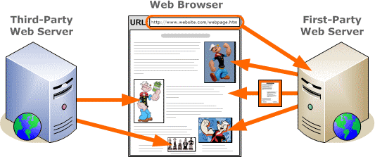
First Party v. Third Party Tracking

Slide 8
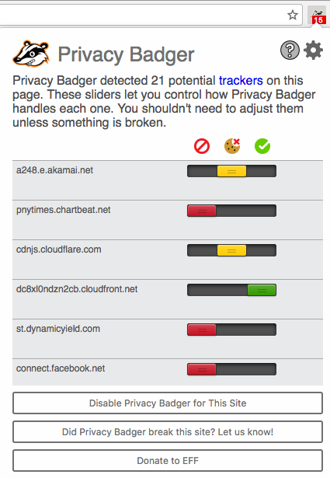

Slide 9
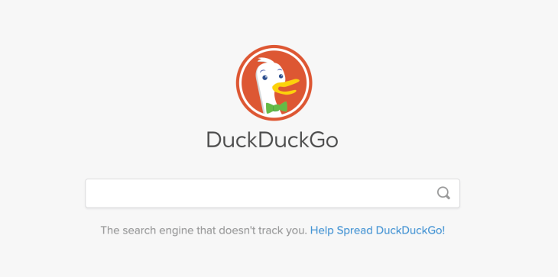
Notes:
Now even with all this tracking blocked we still cant block first party tracking – i.e. from the website you are visiting. So when we visit a website like google.com, which offers other web services like drive.google.com or maps.google.com they can link your searches with your stored files or location and then target advertising based on the content of that.
That’s why we have duckduckgo installed as the default search engine on firefox now.

Slide 10
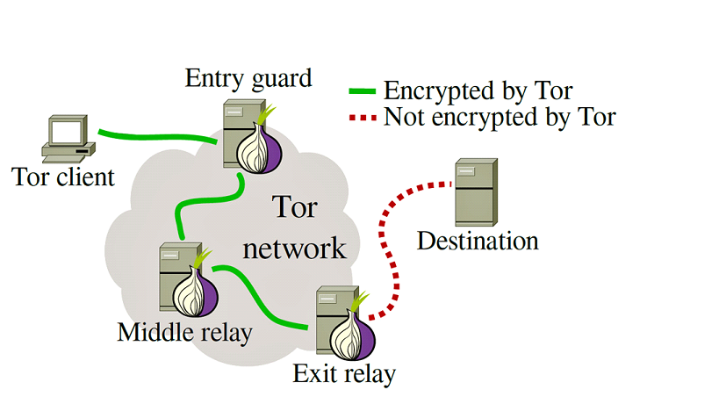
Notes:
Switch to actual tor browser on this slide and show them onion websites after explaining it.

Slide 11
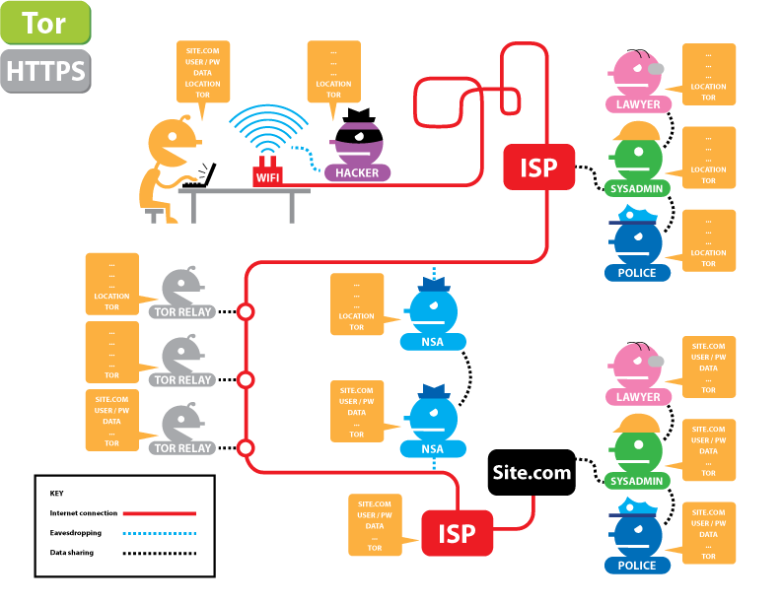
Notes:
Show this one and then the https one to explain https everywhere

Slide 12
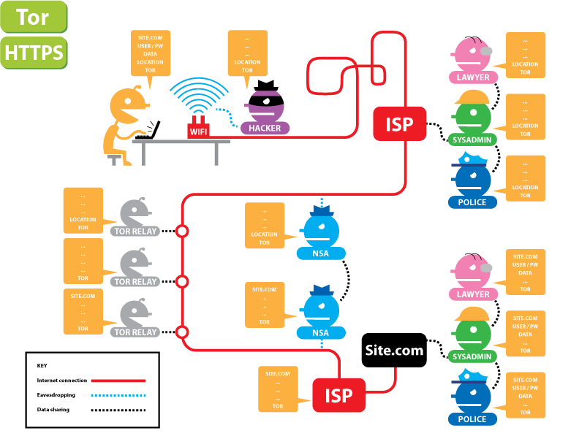

Slide 13
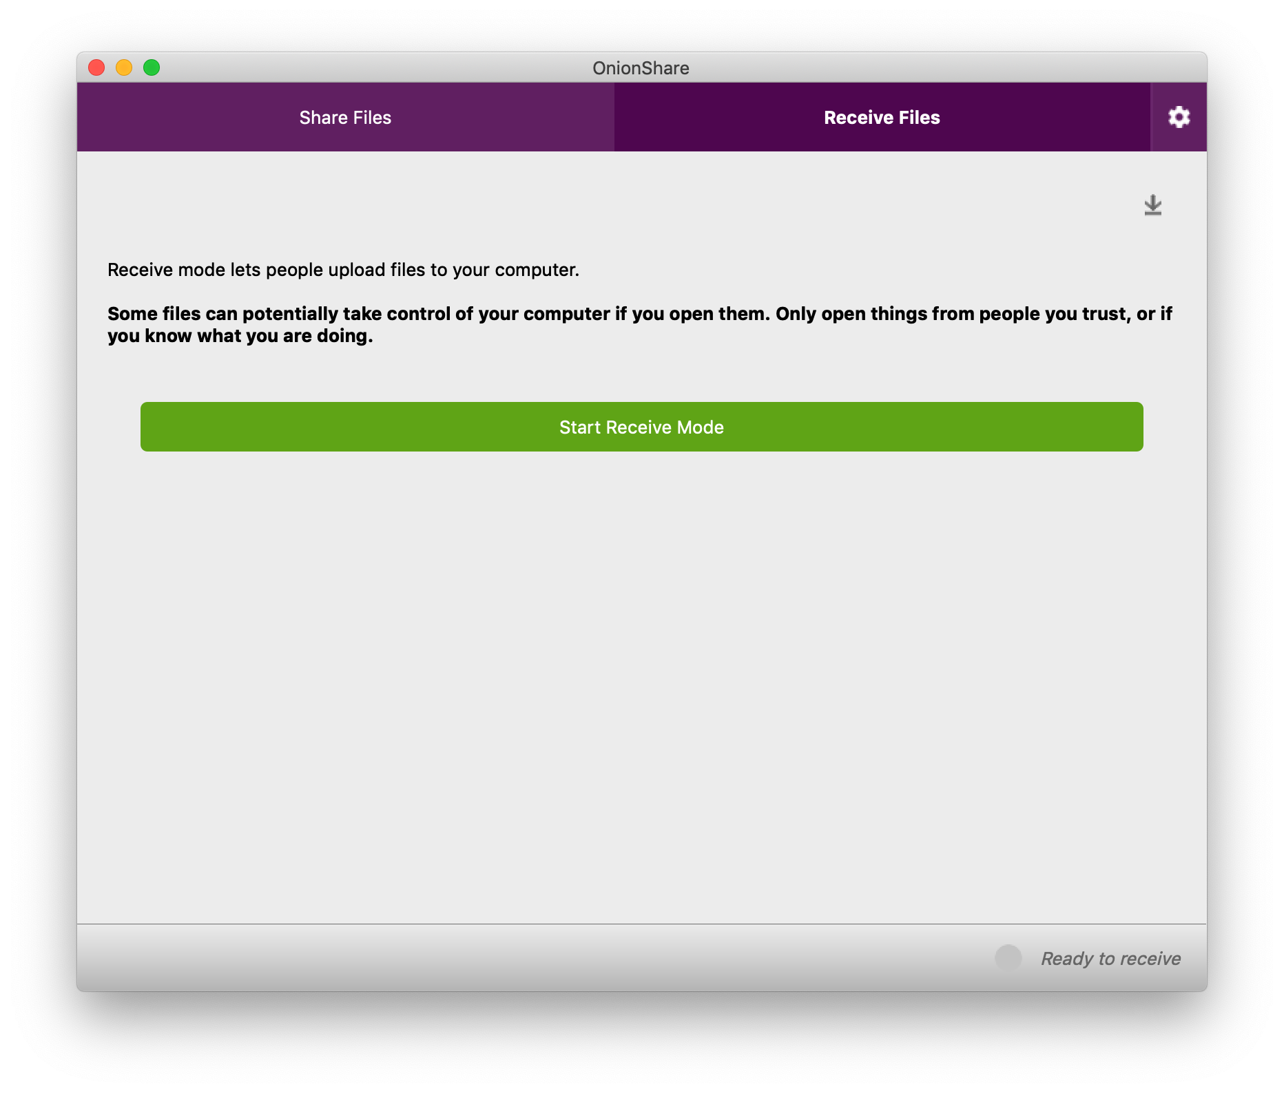
Notes:
Switch to onion share and talk about the reason to use it goes back to first party tracking, i.e. cloud services

Slide 14
